Slide 1
Gizmo City
Jessica Pan – Marjory Stoneman Douglass High
Dalton Poe – Hallandale High
Leehe Mahalal – Pompano Beach High

Slide 2
App Content
Timers & Hints
Fun facts
Games & Trivia
Appealing display of information
Visuals of exhibits
Useful & interesting information

Slide 3
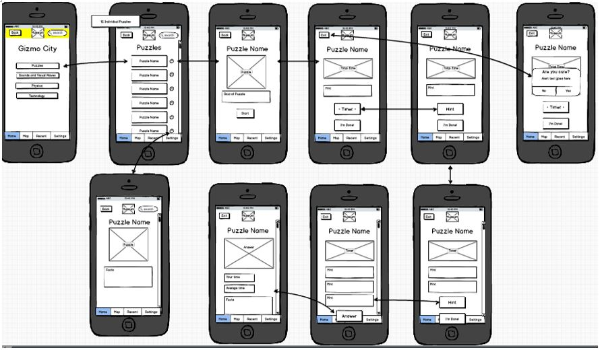
Earlier Designs

Slide 4
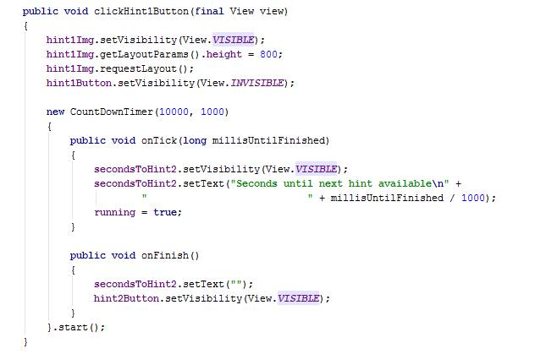
Android Studio Code

Slide 5
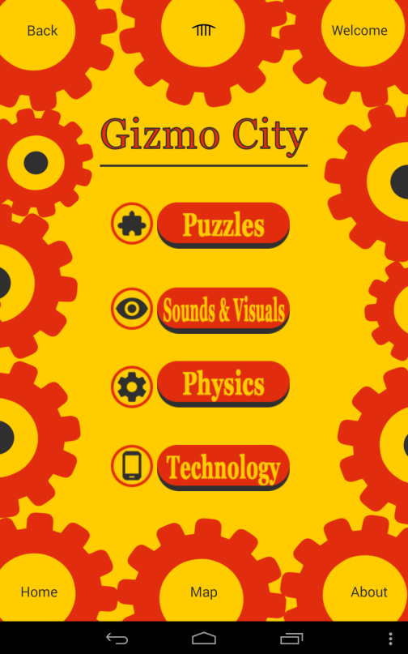
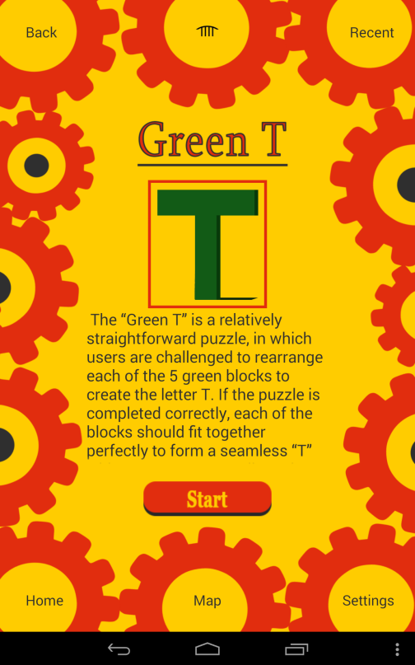
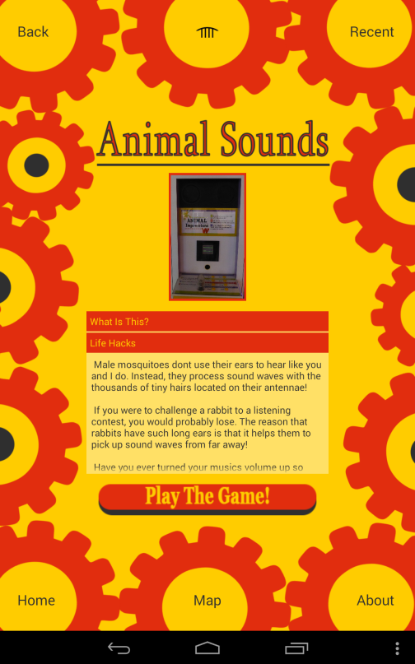
Android Studio UI Interface

Slide 6




Graphics
Color Scheme Concepts
Yellow - The museum’s official color – Used for background.
Orange – A recurring color within Gizmo City – Used for buttons, titles, & backgrounds.
Gray – A contrast against the bright yellow & orange – Used for buttons, titles, backgrounds.
Design
The buttons were intended to match the color scheme and we desired to add more depth to it by adding the gray underneath the orange as a shadow.
The icons were intended to be simple & modern with a representative picture for each Gizmo City hotspot-
Physics - Gear
Technology - Phone
Sounds & Visual Waves - Eye
Puzzles - Puzzle piece
The gears are a great symbol in our app background due to the prominence of the Physics section as a hotspot. The exhibits that represent physics topics are the most repetitive concepts to be found in Gizmo City.

Slide 7
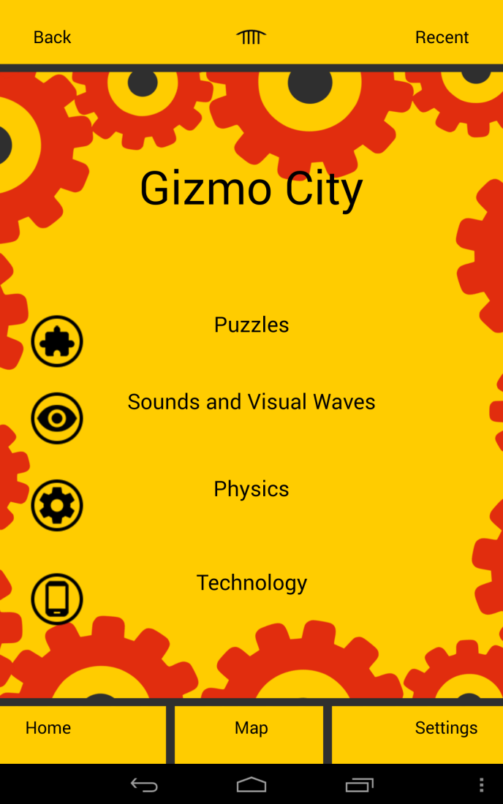
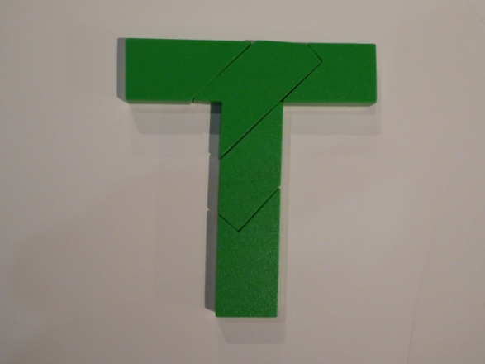








Before

Slide 8




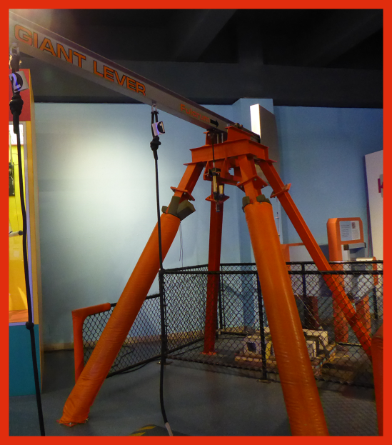



Currently

Slide 9
Demo

Slide 10

Video

Slide 11
Credits
This Gizmo City application was developed by Jessica Pan (coding), Dalton Poe (user interface), and Leehe Mahalal (graphics).
We would foremost like to thank Fort Lauderdale’s Museum of Discovery and Science for granting us this amazing opportunity, as our application would be nonexistent if not for the museum’s “APP-titude” internship program. We would like to thank museum employees Summer Scarlatelli and Joe Cytacki for being fantastic mentors and museum representatives, as well as backing the entire APP-titude team.We would also like to thank our respective high schools, Stoneman Douglass High, Stranahan High, and Pompano Beach High, for providing us the opportunity to participate in this internship. Additionally, we would like to thank Florida Atlantic University for providing us with their “Mobile Applications for Google’s Android” class. Moreover, we would like to show our gratitude to Florida Atlantic University professors Ravi Shankar, Francis McAfee, and Diana Mitsoba-Boneva, as well as their teaching assistants Santiago Aguerrevere and Demetrius Dukes, for providing us their instruction and guidance. We would also like to give reference to the novels “Hello Android” by Ed Burnette and "Android Studio Essentials" by Neil Smythe, as each were of great use when developing “Gizmo City.” For graphics, we’d like to thank Google Design for the icon concepts and ideas provided. Last but not least, we would like to show our gratitude to the United Way of Broward County for sponsoring the APP-titude program and helping make all of this possible.

